Slide 1
Counterexample doesn’t work?

Slide 2
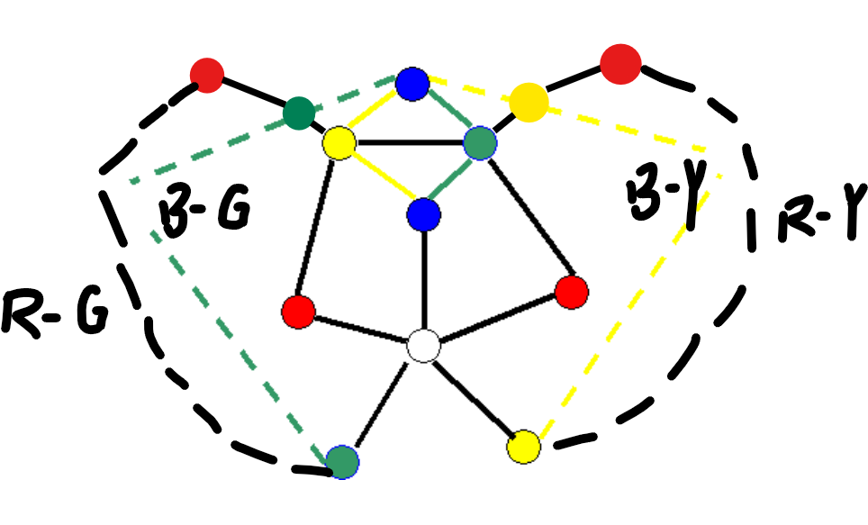

Slide 3
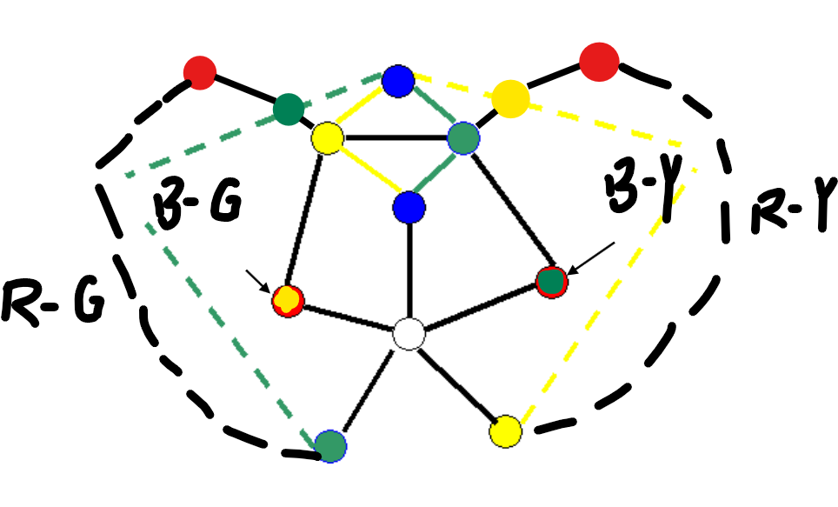

Slide 4
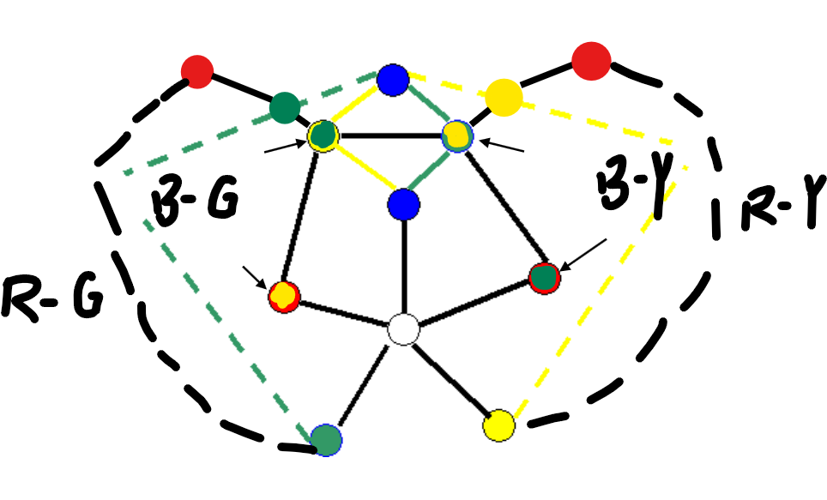

Slide 5
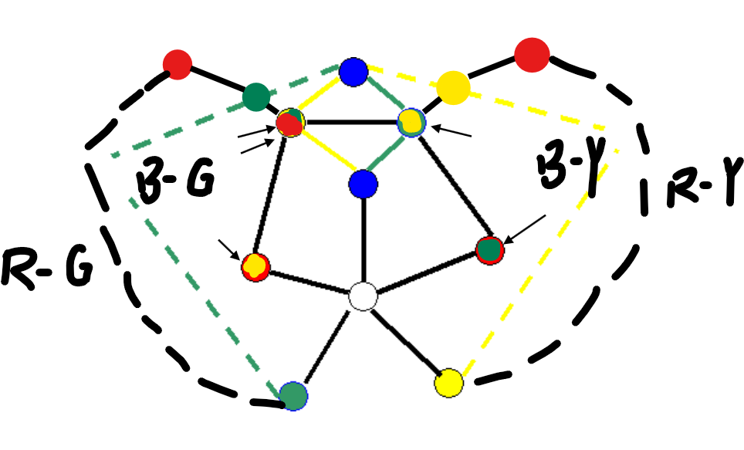

Slide 6
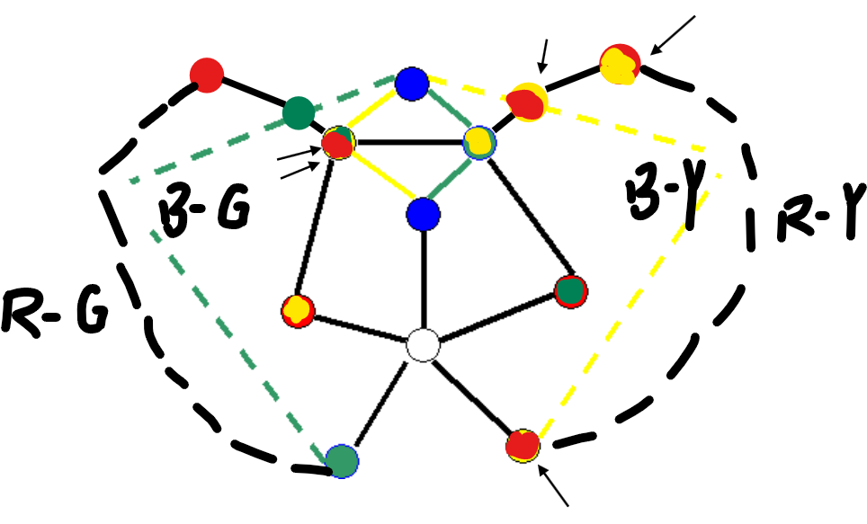

Slide 7
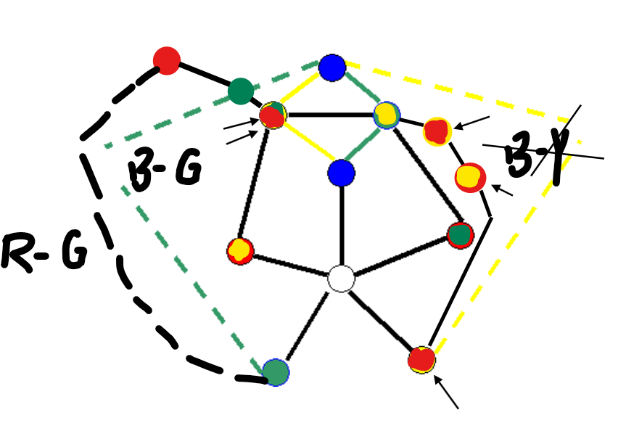
Case2: If the kempe chain was on the inside.
The B-Y kempe chain is destroyed from the R-Y toggling?

Slide 8
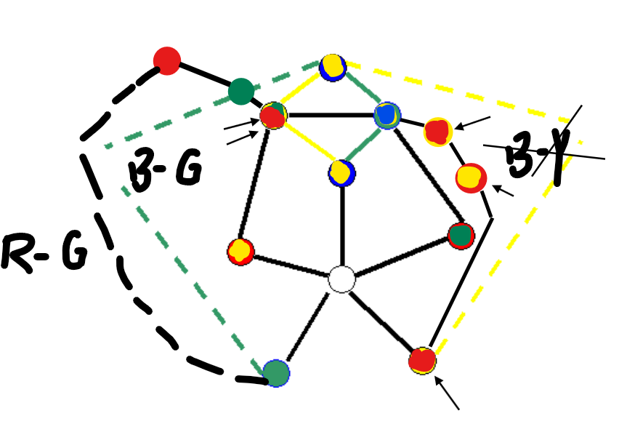
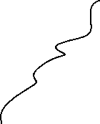


Middle can be B now?

Slide 9
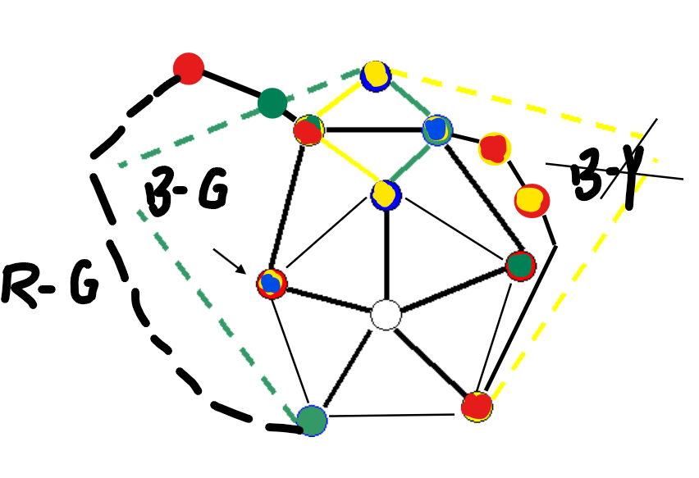
Assume maximal planarity. Try to get (*) to become B or Y.
*
“the four color map theorem, states that no more than four colors are required to color the regions of any map so that no two adjacent regions have the same color.” This means maximal planarity must be assumed. Doing this also doesn’t seem to break anything we did previously though.

Slide 10
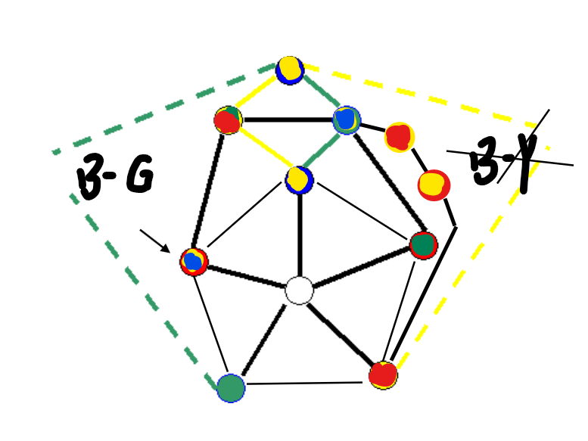
*
Get rid of R-G Kempe Chain on left side. This makes it harder to make the bottom right (RED) a BLUE or YELLOW (our attempt).

Slide 11
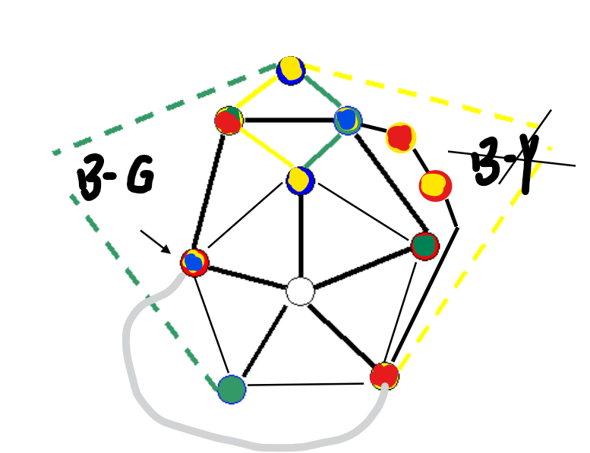
There is NO kempe chain from Blue to Red (gray line). The original B-G kempe chain blocks it off, and there is Y on top now.
Toggling Y-B kempe chain on top doesn’t nothing.
*

Slide 12
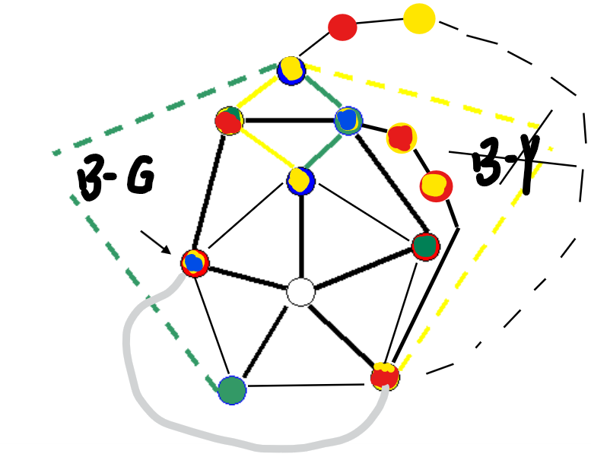
There can be kempe chain from R-Y
*
*

Slide 13
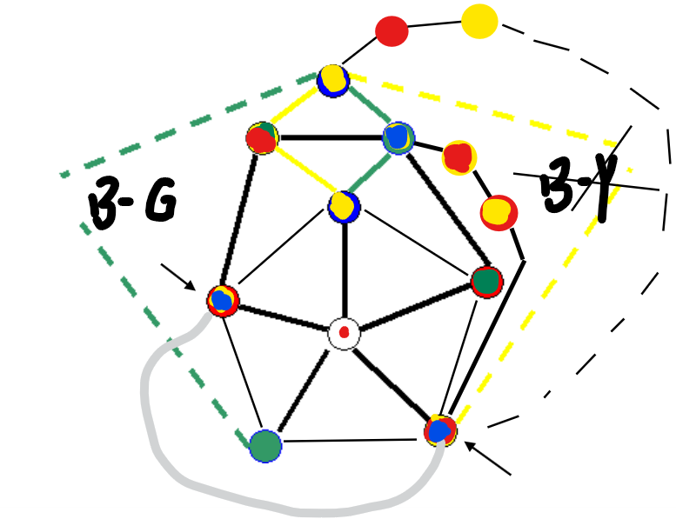
Counterexample doesn’t work?
**
RED
* to blue

